Slide 1

Elements of Seismology & Machine Learning
Gabriele Paoletti
gabriele.paoletti@uniroma1.it
Elisa Tinti
elisa.tinti@uniroma1.it
Daniele Trappolini
daniele.trappolini@uniroma1.it

Slide 2
Opening
Table of contents
Introduction
3
02. Machine Learning
9
03. Deep Learning
16
04. Training
26
05. Applications
38

Slide 3
01.
Introduction
This section serves as an introduction to our comprehensive exploration of artificial intelligence. We'll provide an overview of key concepts, history, and the impact of AI and machine learning technologies in various sectors.

Slide 4
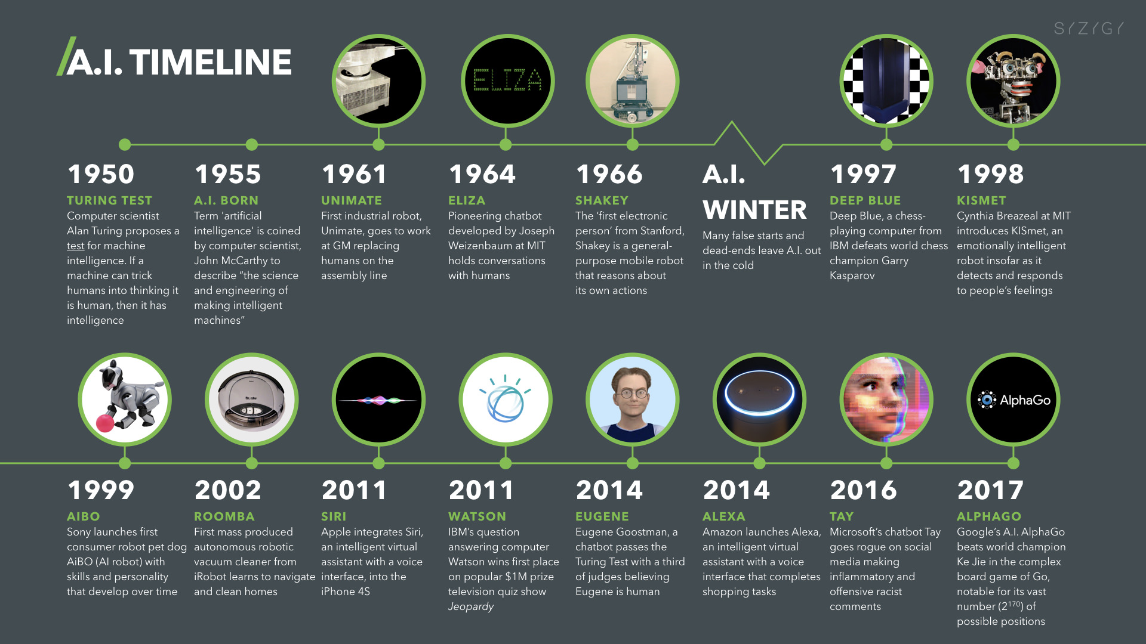

Slide 5
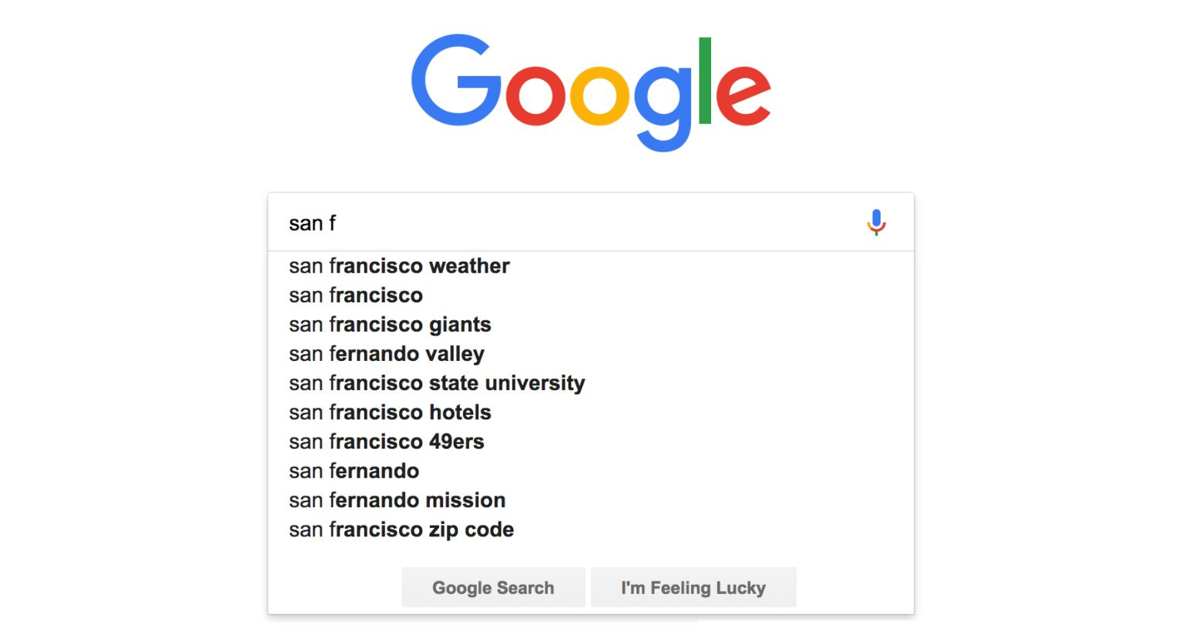
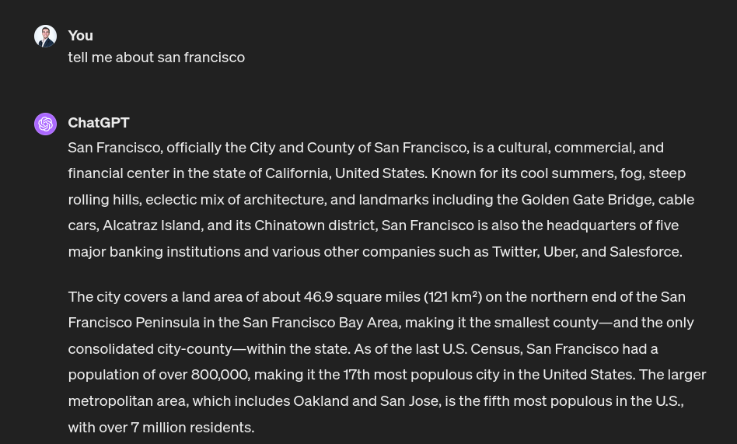
Introduction
Text to text: ChatGPT
December 10, 2004
November 30, 2022
“Tell me about San Francisco”

Slide 6
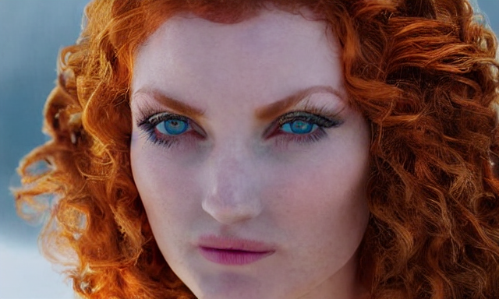

Introduction
Text to image: Midjourney
October 15, 2022
March 05, 2023
“A young woman with vibrant red hair and striking blue eyes stands amidst a gentle snowfall, medieval-inspired armor, …”

Slide 7
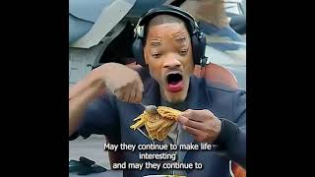
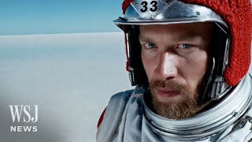
Introduction
Text to video: Sora
March 30, 2023
February 15, 2024
“A movie trailer featuring the adventures of the 30 year old space man wearing a red wool knitted motorcycle helmet, blue sky, salt desert, cinematic style, shot on 35mm film, …”

Slide 8

Introduction
Artificial intelligence

Slide 9
02.
Machine Learning
This section explores the fundamentals of Machine Learning, covering key concepts and techniques used to enable machines to learn from data.

Slide 10
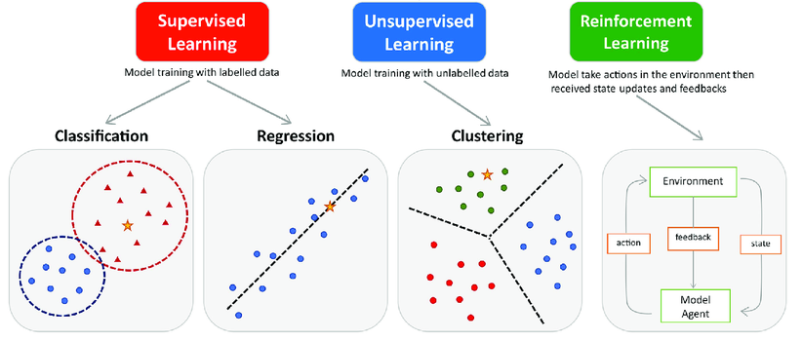
Machine Learning
Three main paradigms
“Machine Learning is a field of study that gives computers the ability to learn without being explicitly programmed” ~Arthur Samuel (1959)

Slide 11
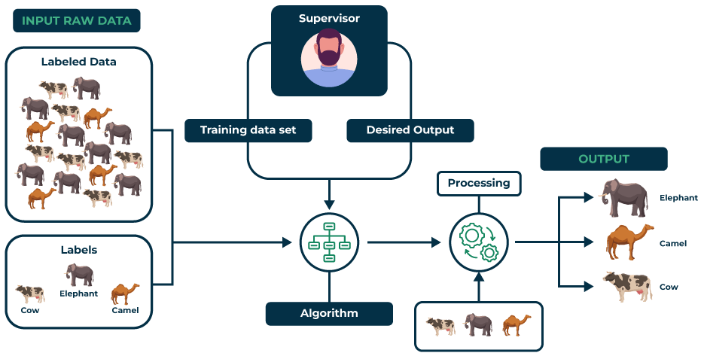
Machine Learning
Supervised learning

Slide 12
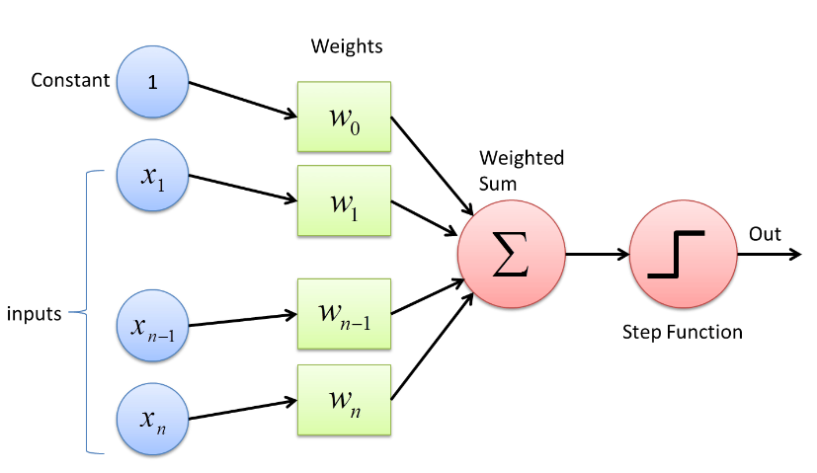
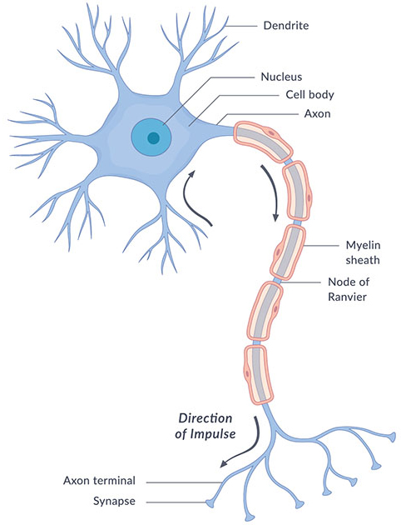
Machine Learning
Supervised learning: Perceptron
Rosenblatt et al. 1957

Slide 13
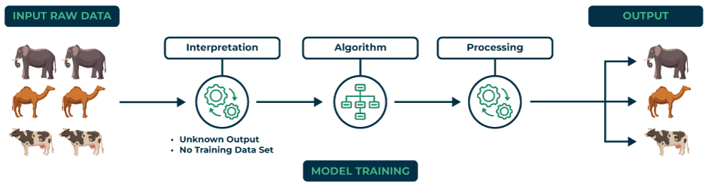
Machine Learning
Unsupervised learning
Unsupervised learning is a type of machine learning where models discover patterns in data without pre-existing labels, often used for clustering or dimensionality reduction.

Slide 14
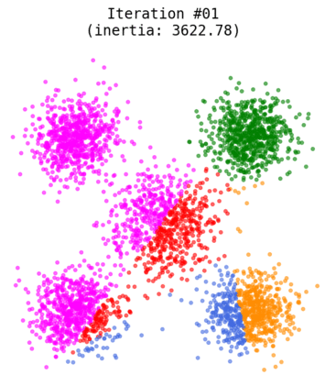
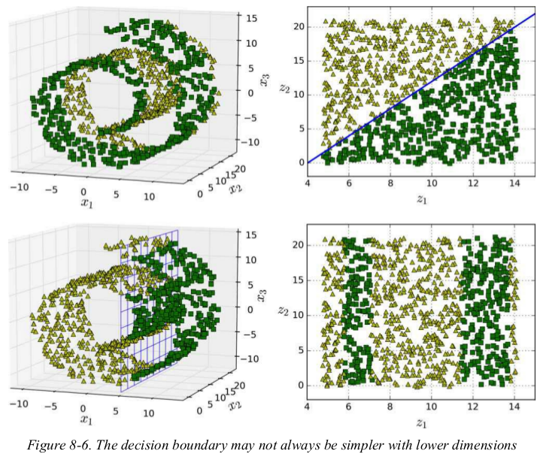
Machine Learning
Unsupervised learning: K-Means / PCA
K-Means
PCA

Slide 15
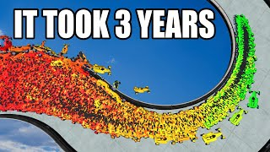
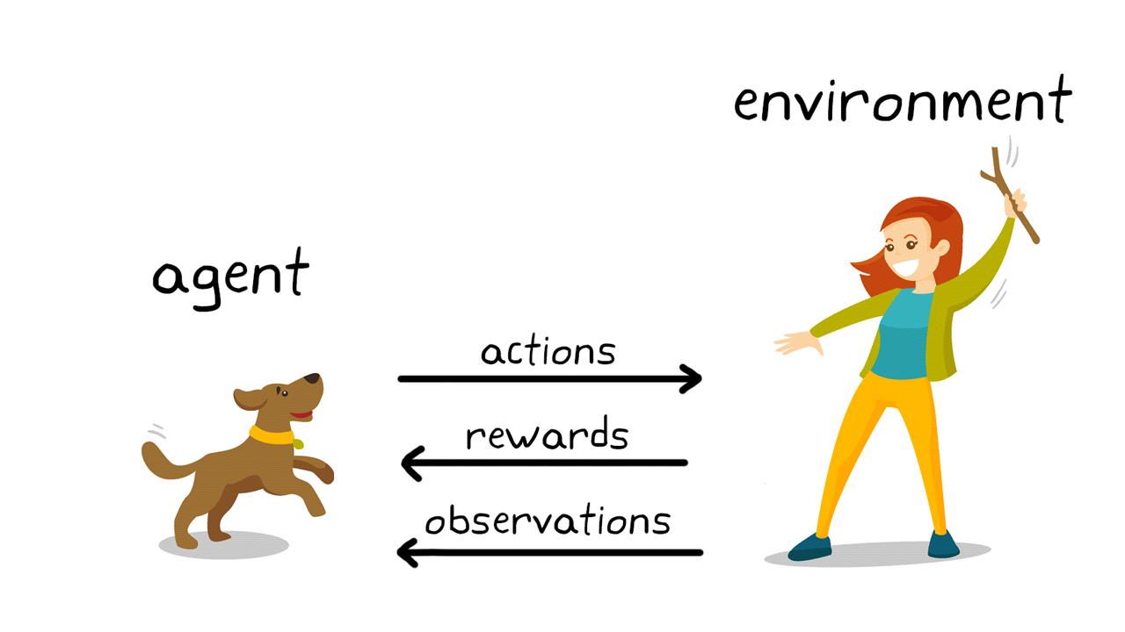
Machine Learning
Reinforcement learning
Reinforcement Learning is a machine learning method where an agent learns optimal actions through trial and error to maximize rewards in an environment.

Slide 16
03.
Deep Learning
In this section, we focus on Deep Learning, a subset of machine learning that utilizes neural networks with many layers. We'll examine how deep learning models can learn complex patterns and perform tasks like image and speech recognition.

Slide 17
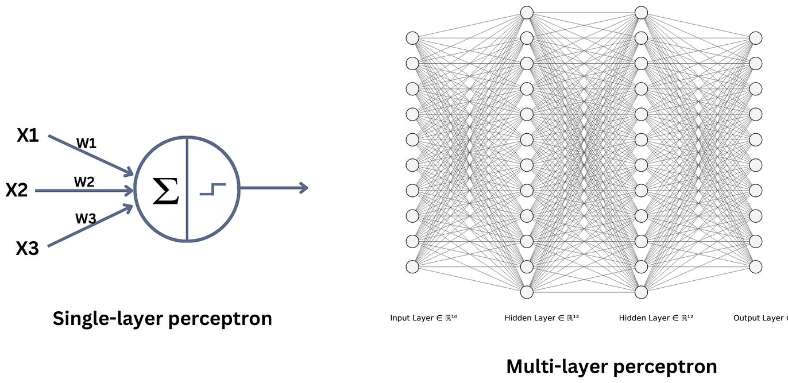
Deep Learning
Neural Networks (NNs)
A computational model inspired by the human brain's structure, and consists of layers of interconnected nodes or neurons that process and transmit signals to solve tasks.

Slide 18
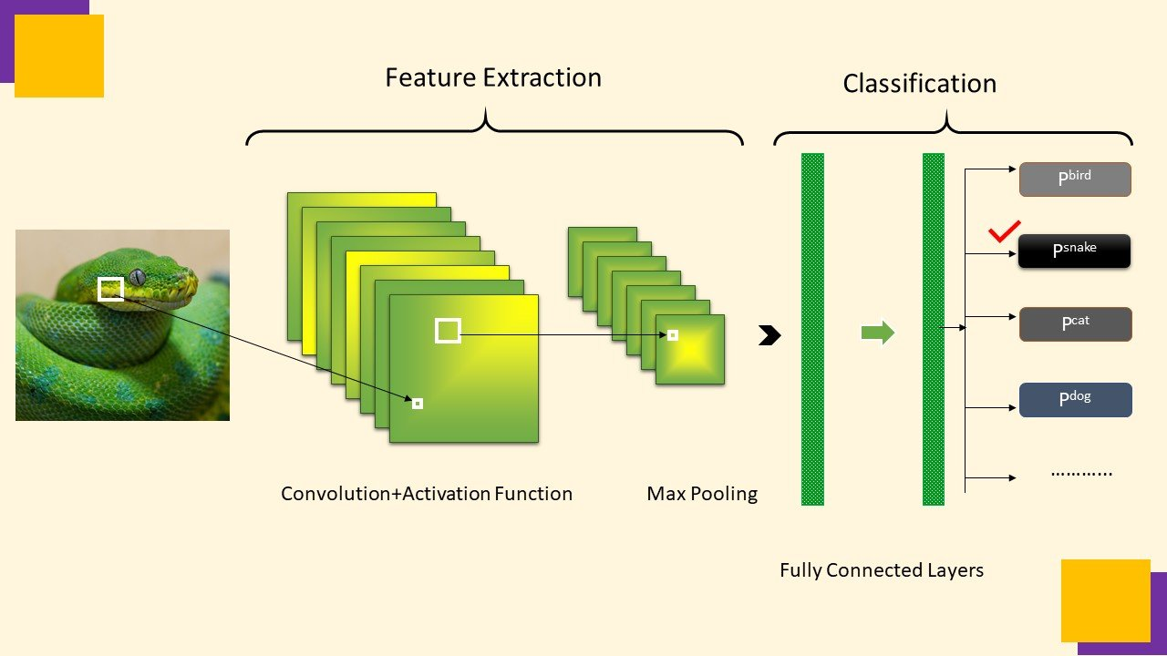
Deep Learning
Convolutional Neural Networks: What is a convolution
Convolution involves sliding a smaller array, known as a kernel or filter, over a larger array (the input signal or image) to produce a new array called the convolved feature or feature map.

Slide 19

Deep Learning
Convolutional Neural Networks (CNNs)

Slide 20

Deep Learning
Convolutional Neural Networks: Task
Classification
Classification +
Localization
Object detection
Instance segmentation

Slide 21
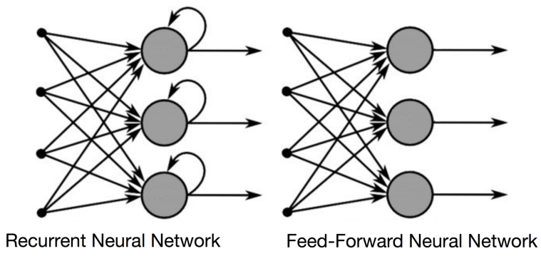
Deep Learning
Recurrent Neural Network (RNNs)
CNNs struggle with time series because they don't naturally keep track of the order of things. They treat input data as if all parts are independent and don't have a built-in way to remember what happened in the previous steps of a sequence.

Slide 22
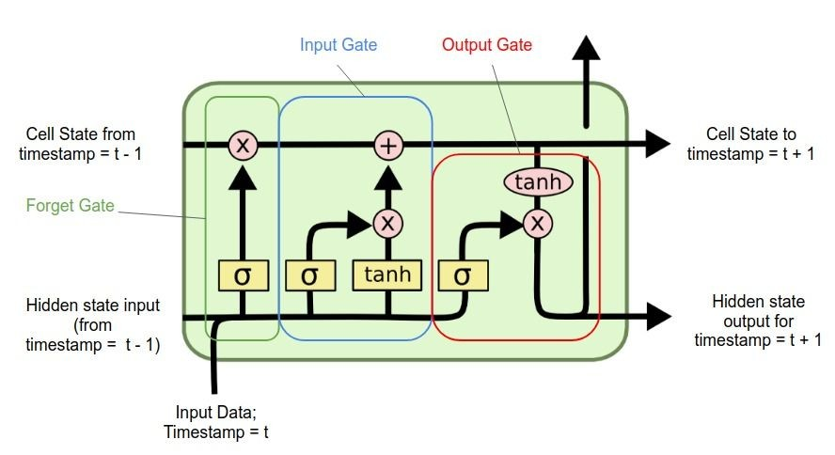
Deep Learning
Recurrent Neural Networks: LSTM

Slide 23
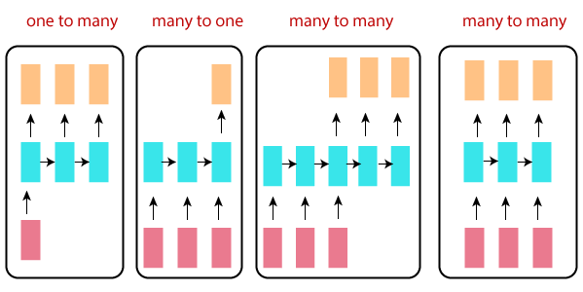
Deep Learning
Recurrent Neural Networks: Task
Image
captioning
Sentiment analysis
Text generation or
machine translation
Speech tagging or named entity recognition

Slide 24
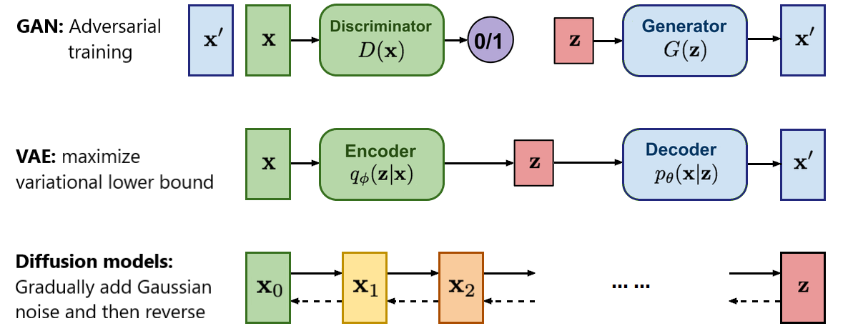
Deep Learning
Generative Neural Network (GANs)
A class of models designed to generate new data that is similar to the training data they've been fed. They learn the underlying distribution of a dataset and then use this knowledge to produce new instances that could plausibly come from the same distribution.

Slide 25
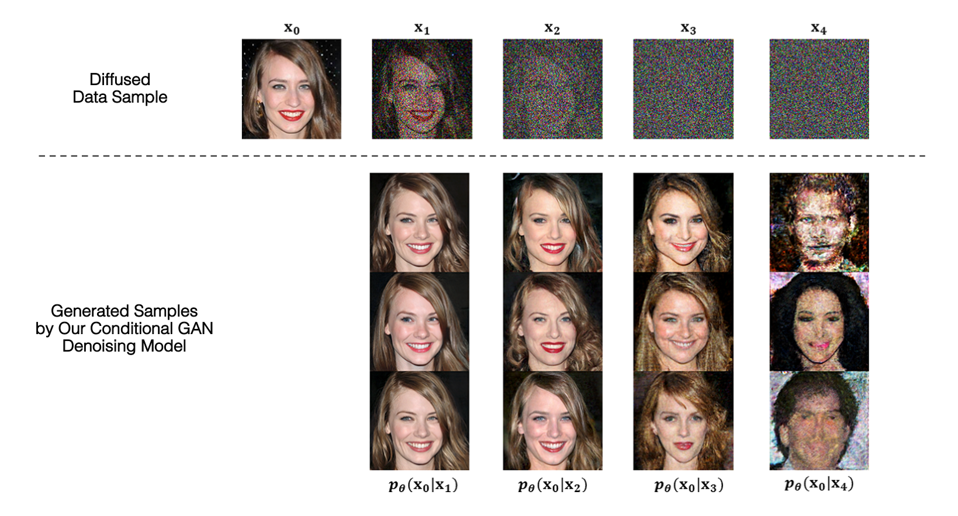
Deep Learning
Generative Neural Networks: Task
The website This Person Does Not Exist was created in February 2019. It uses GANS, to generate highly realistic images of human faces of people who do not actually exist. https://this-person-does-not-exist.com/en

Slide 26
04.
Training
Here, we discuss the process of training machine learning models, including data preparation, model selection, and the use of algorithms to optimize model performance. We'll also cover strategies to avoid common pitfalls like overfitting.

Slide 27
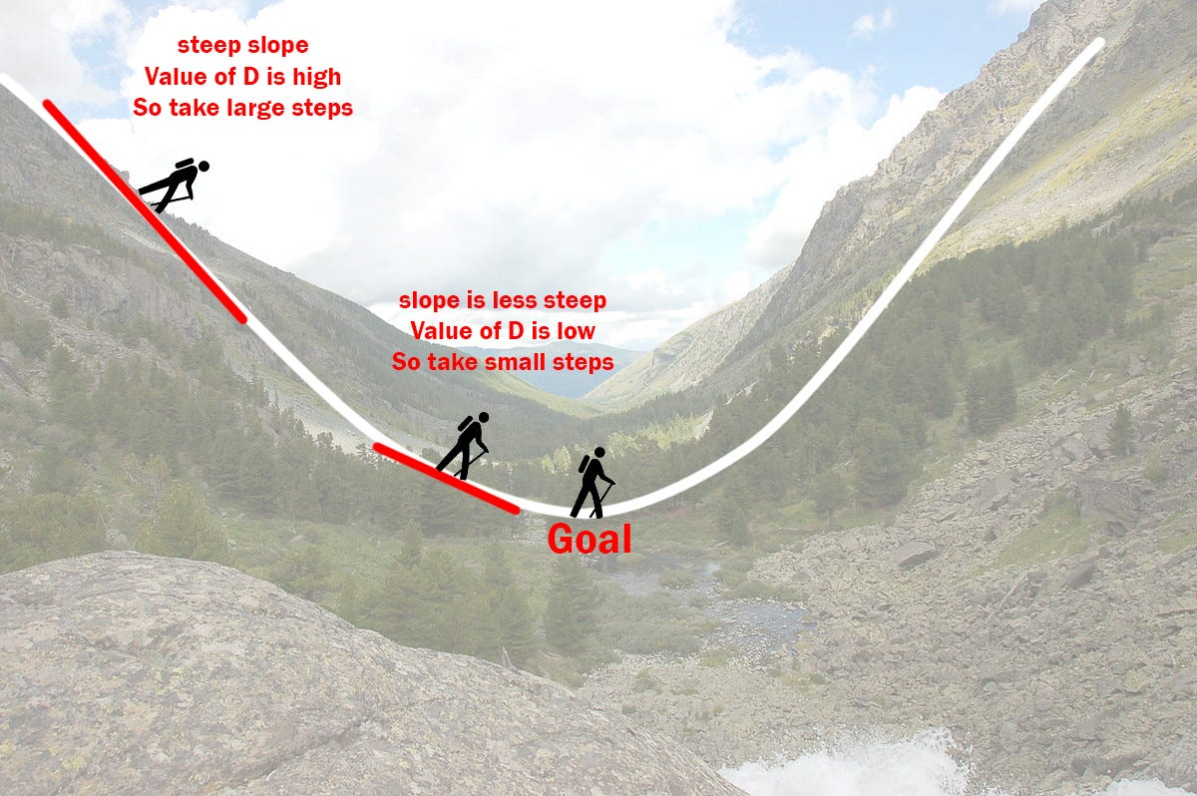
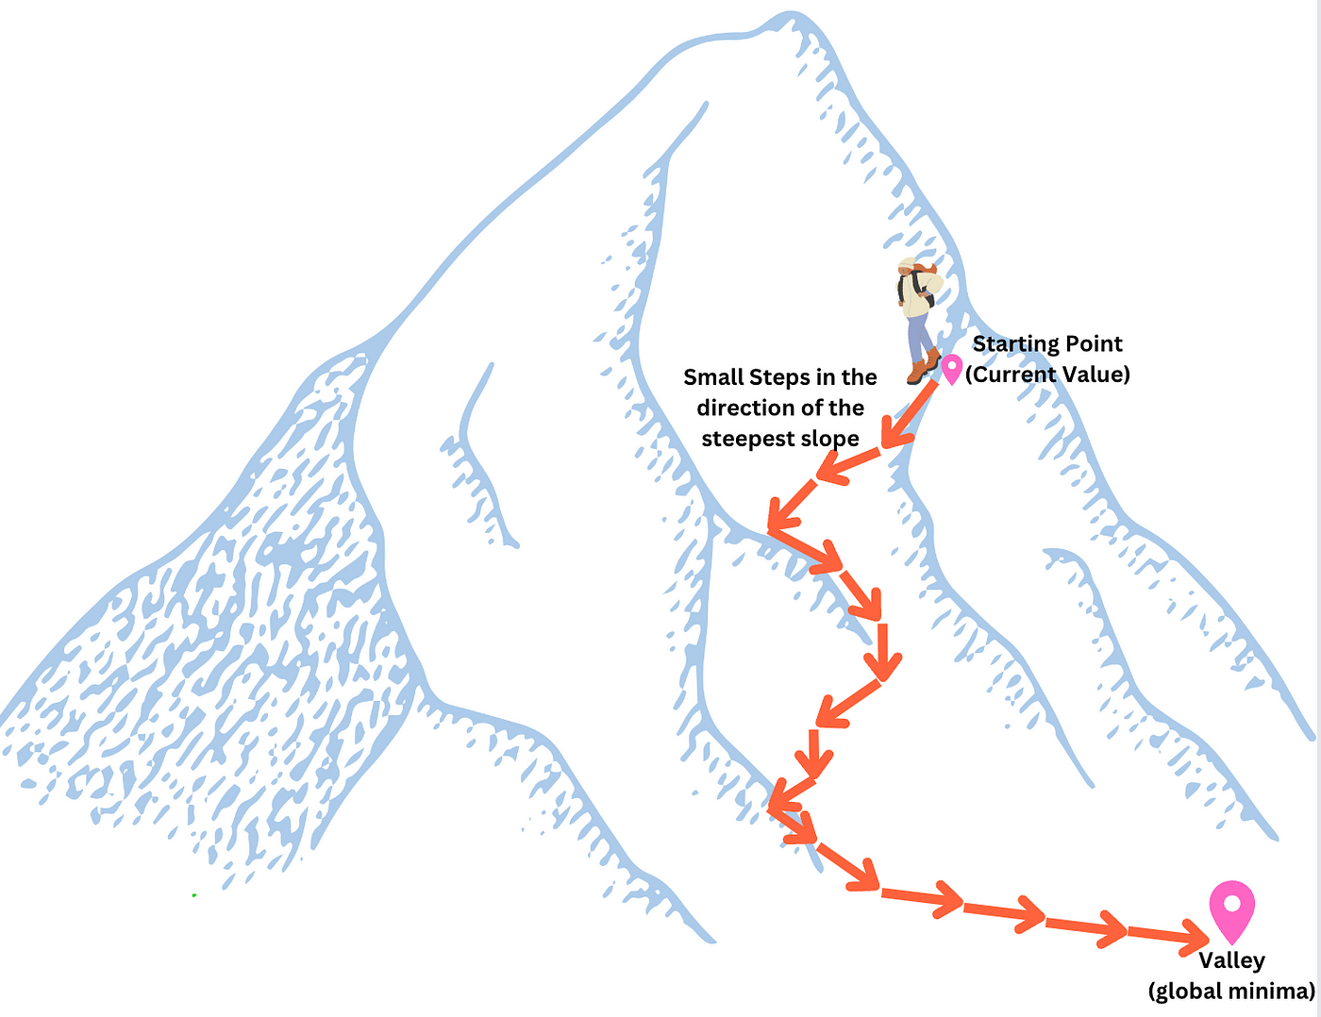
Training
Gradient descent
Is an optimization algorithm that iteratively adjusts parameters to minimize a cost function, moving in the direction of steepest decrease.

Slide 28
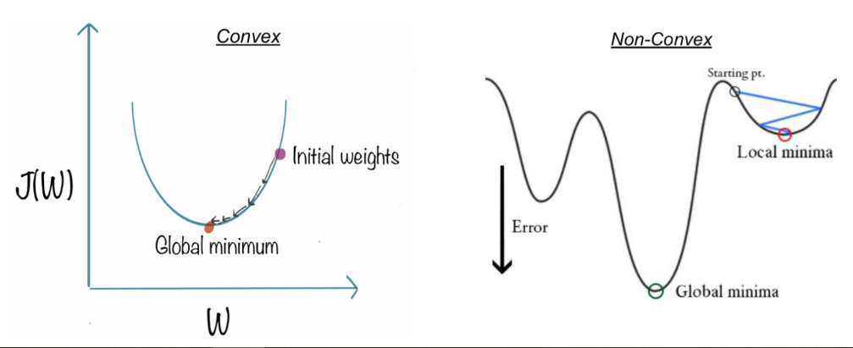
Training
Cost (or loss) function
A mathematical function that measures the difference between the algorithm's predictions and the actual data. It guides the optimization process by quantifying the model's performance.

Slide 29
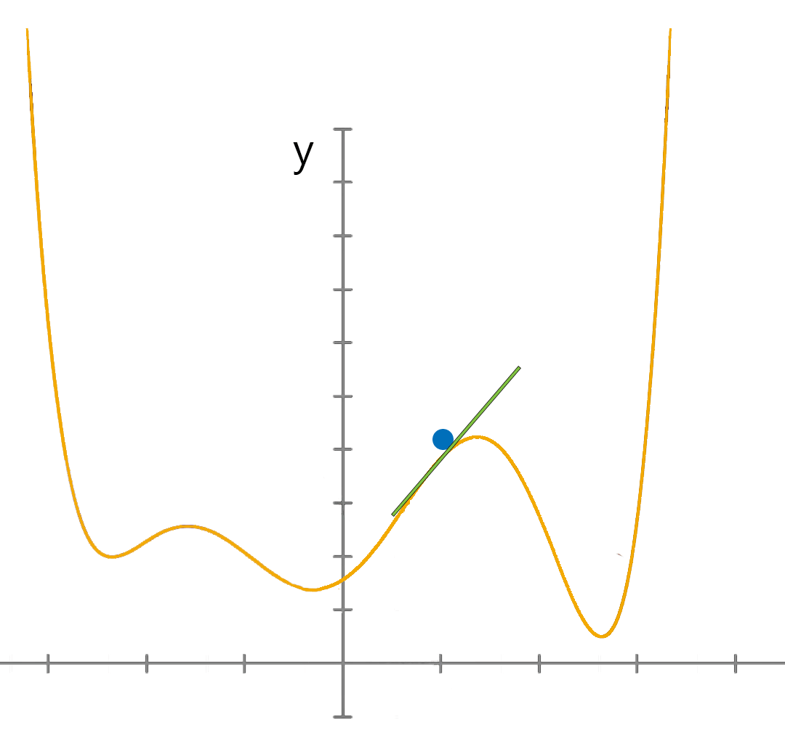
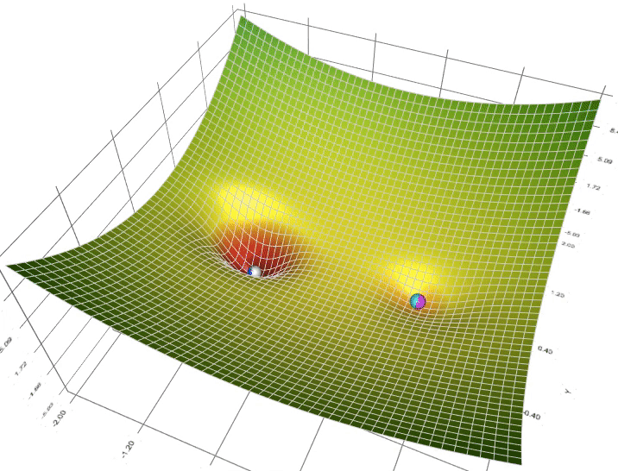
Training
Gradient descent
Is an optimization algorithm that iteratively adjusts parameters to minimize a cost function, moving in the direction of steepest decrease.
Local minima
Global minima

Slide 30
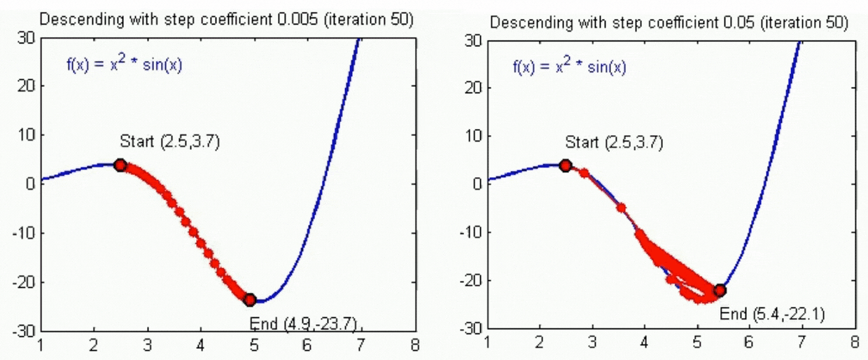
Training
Learning rate
An hyperparameter that controls the adjustment of model weights during training. It determines the size of the steps the algorithm takes to reach the minimum of the loss function.

Slide 31

Training
Backpropagation
An algorithm used to calculate the gradient of the loss function with respect to each weight by the chain rule, efficiently propagating the error backward through the network.

Slide 32

Training
Backpropagation
An algorithm used to calculate the gradient of the loss function with respect to each weight by the chain rule, efficiently propagating the error backward through the network.

Slide 33
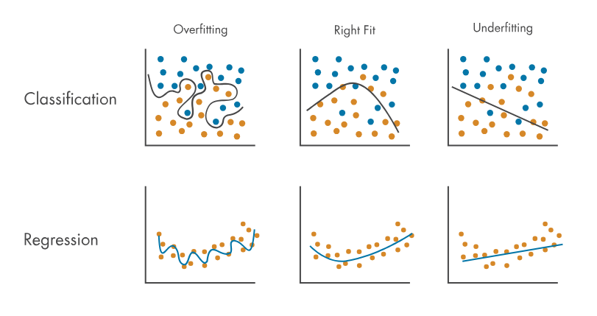
Training
Overfitting and underfitting

Slide 34
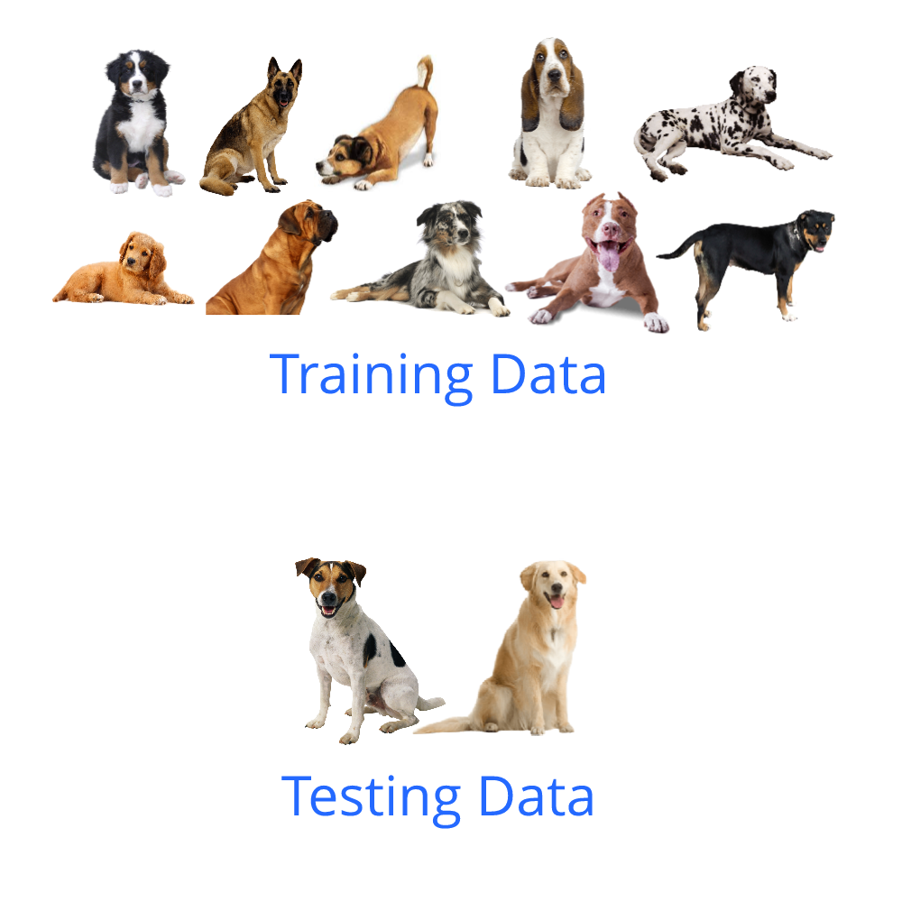
Training
Generalization
Model's ability to perform well on new, unseen data after being trained on a specific dataset. It measures the effectiveness in applying learned patterns to novel inputs outside the training set.
Generalization
Training data
Testing data

Slide 35
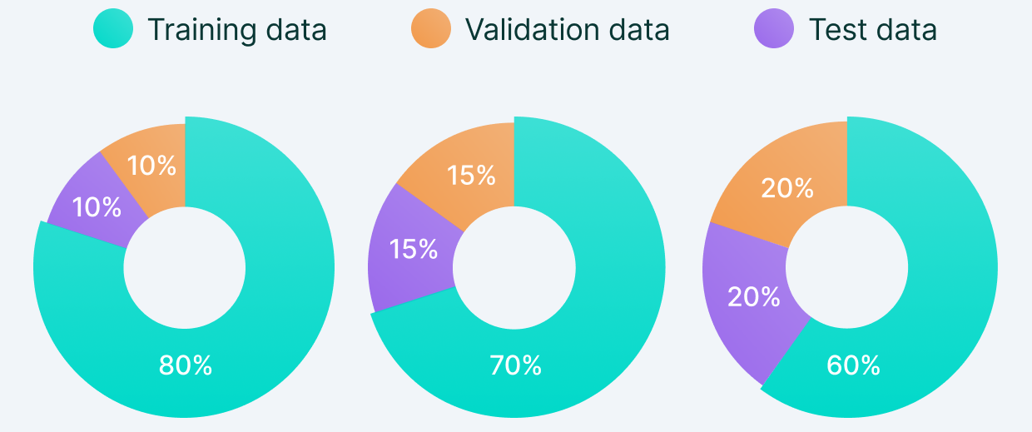
Training
Generalization: Set splitting
A process a dataset is divided into separate subsets to ensure that models are trained on one set of data and tested on unseen data to evaluate performance and generalize ability.

Slide 36
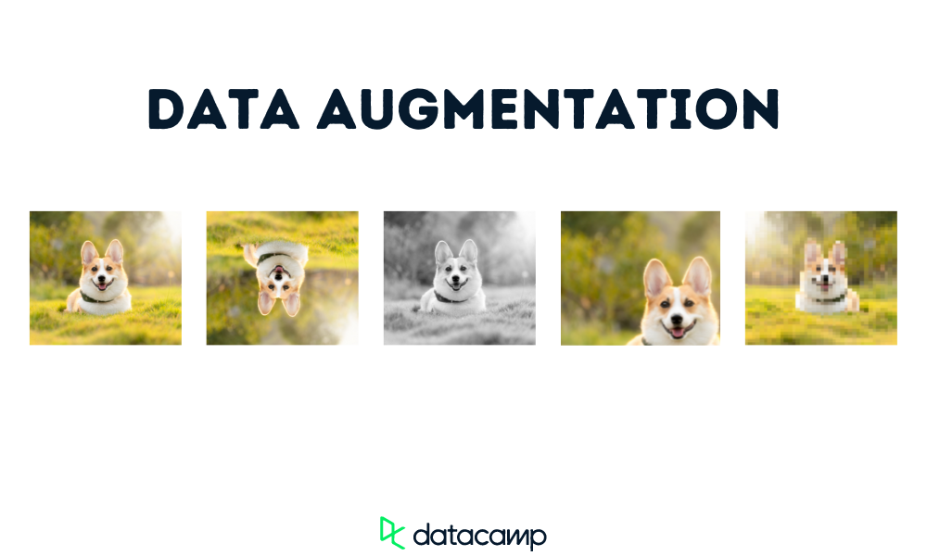
Training
Generalization: Data augmentation
A technique to increase the diversity of training data by applying various transformations, such as rotation, scaling, and flipping, to existing samples. This helps improve model robustness and generalization by simulating a wider range of input scenarios.
Original
Augmentation

Slide 37
Training
Generalization: Regularization
A technique used to prevent overfitting by adding a penalty on the size of the parameters. It encourages simpler models during training, which can generalize better on unseen data.
Regularization

Slide 38
05.
Applications
This section delves into the wide range of applications for machine learning and deep learning in seismology.

Slide 39
05.01
Earthquake classification

Slide 40
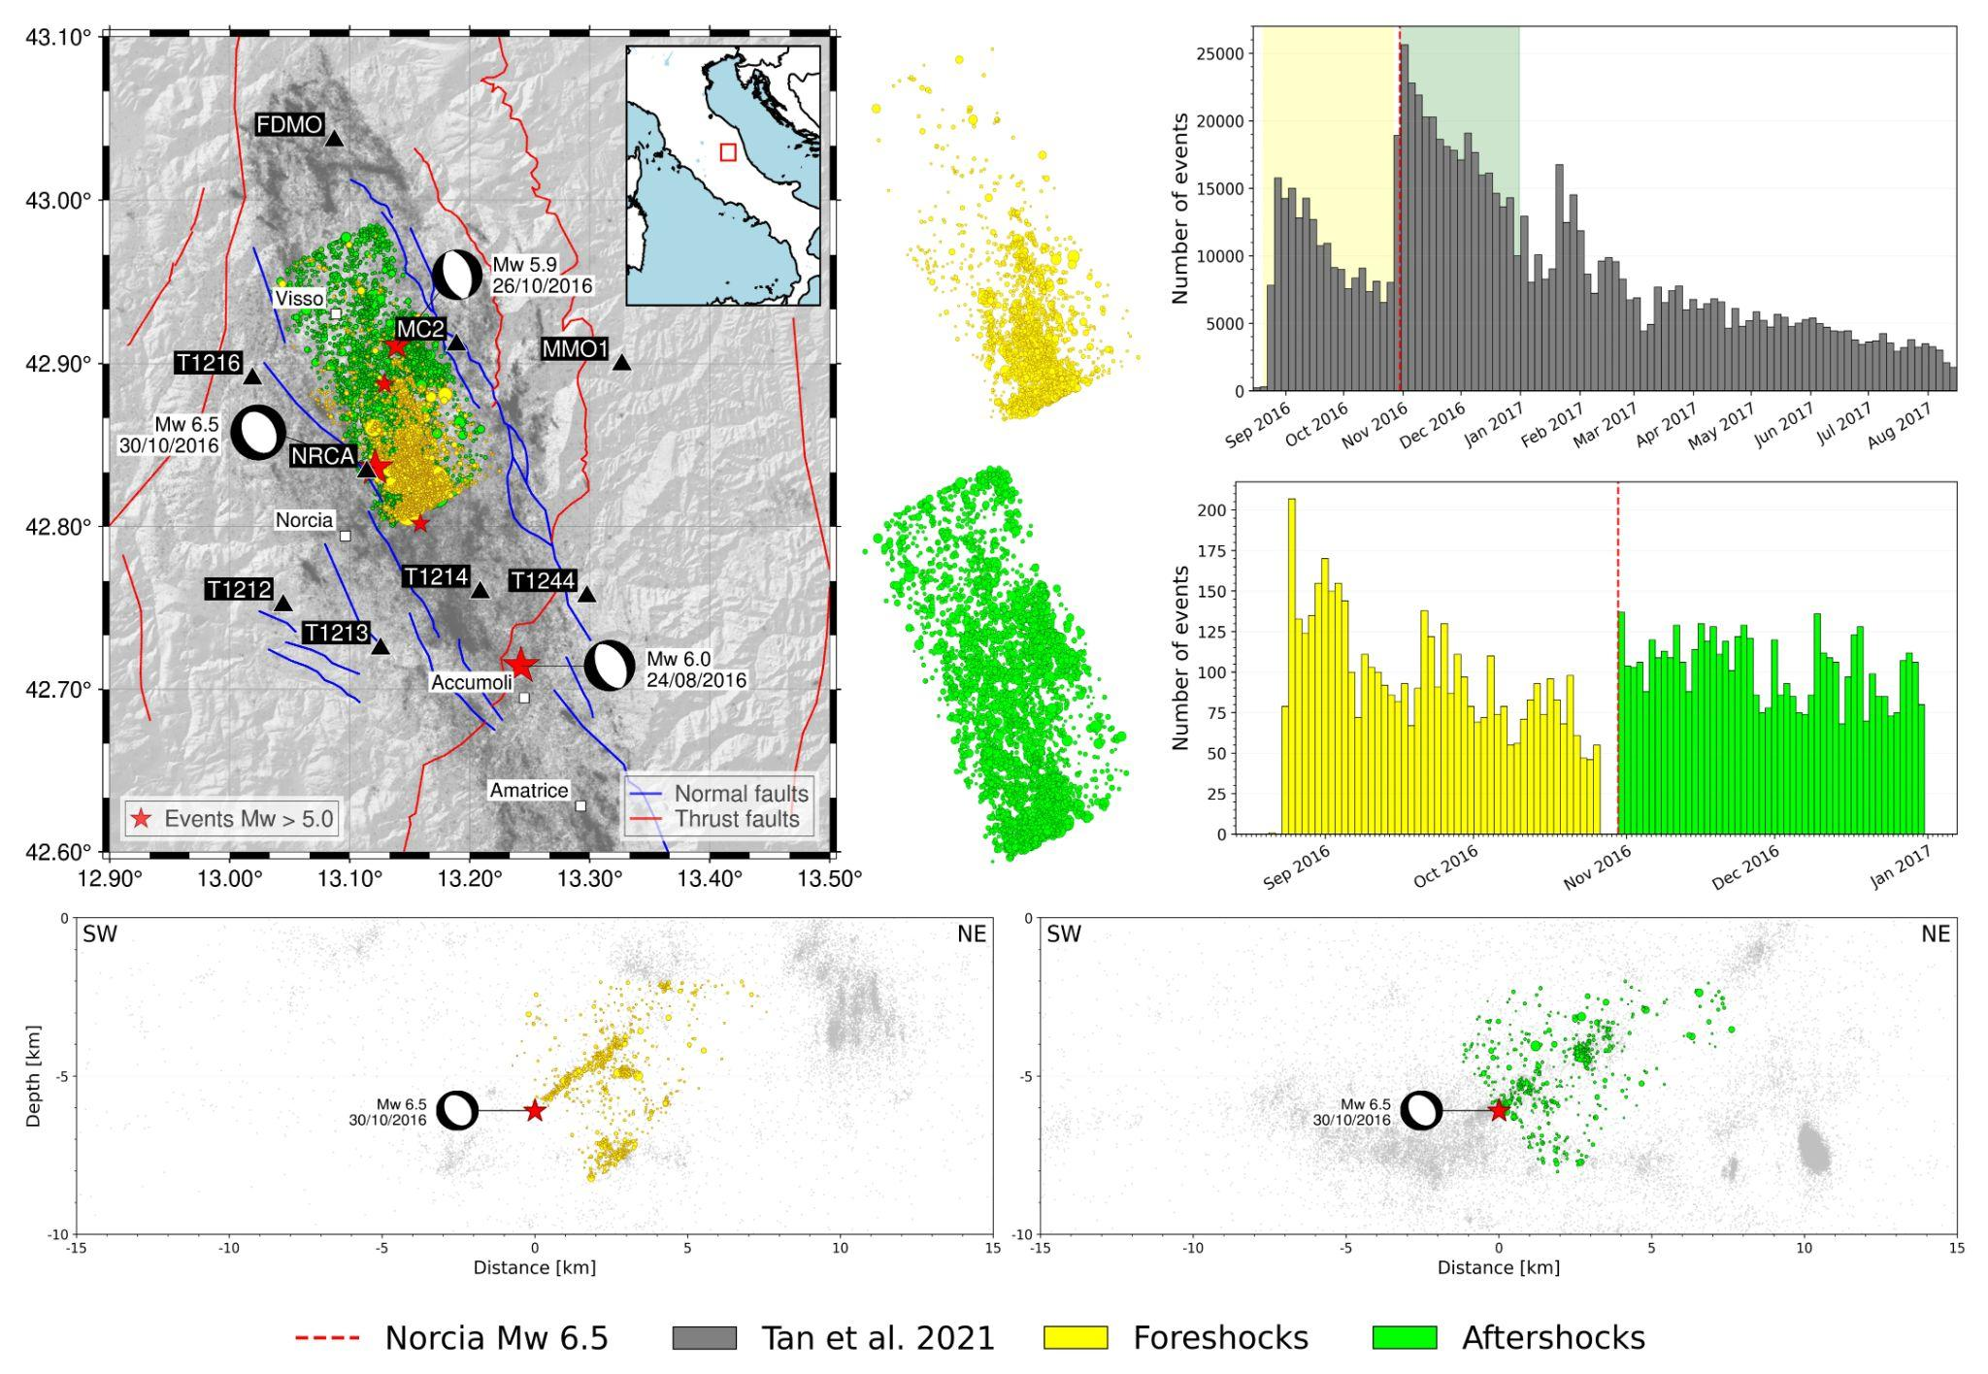
Applications
Earthquake classification

Slide 41
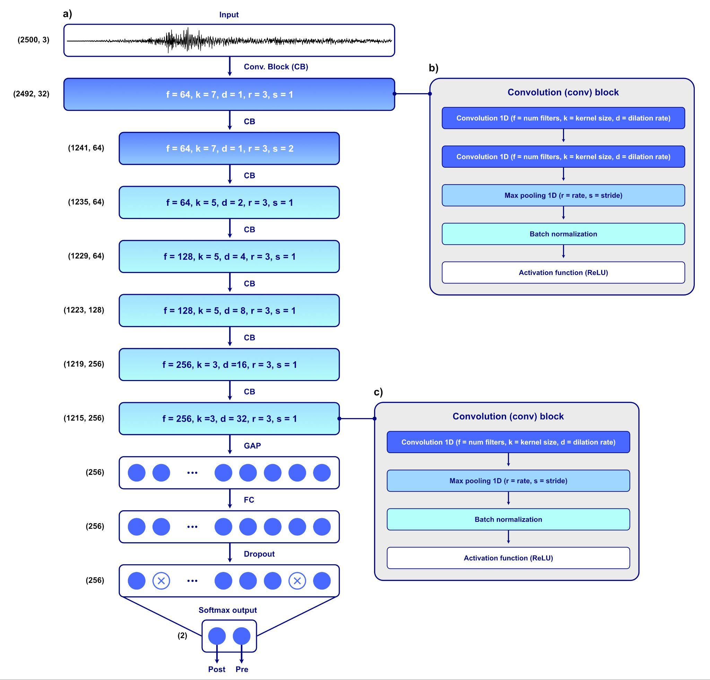
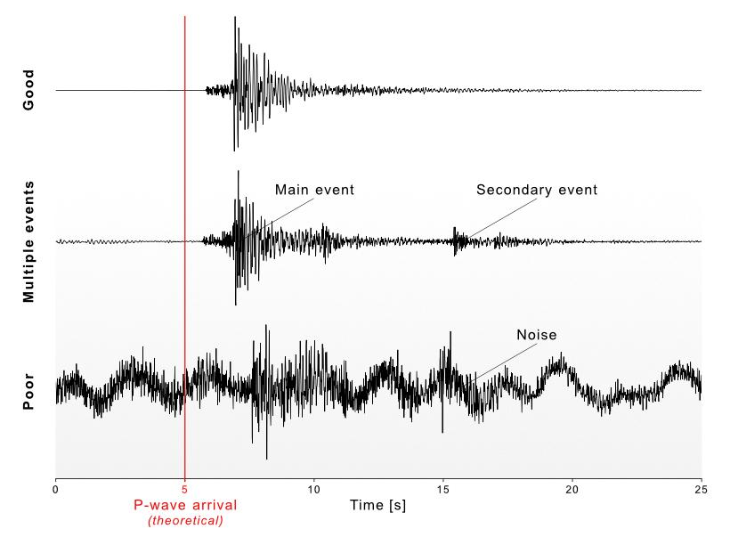
Applications
Earthquake classification: Methods

Slide 42
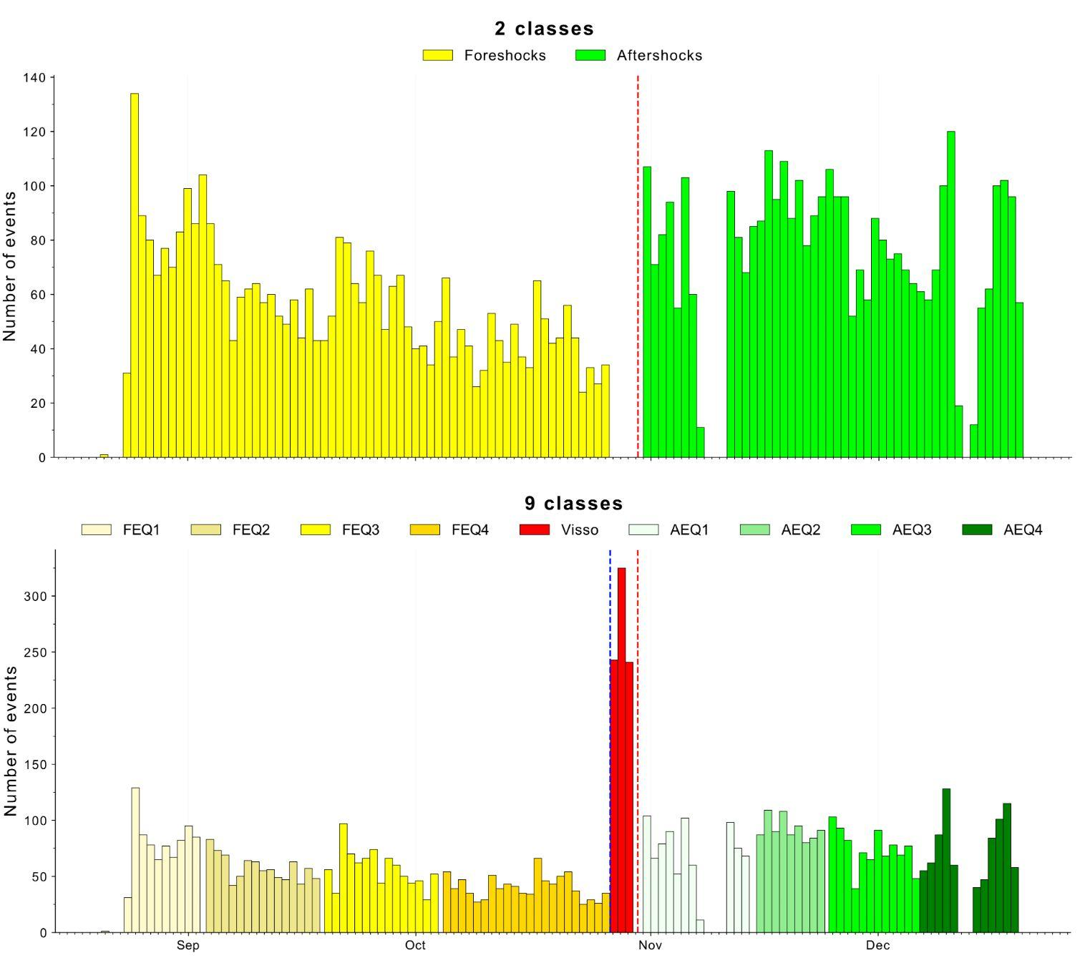
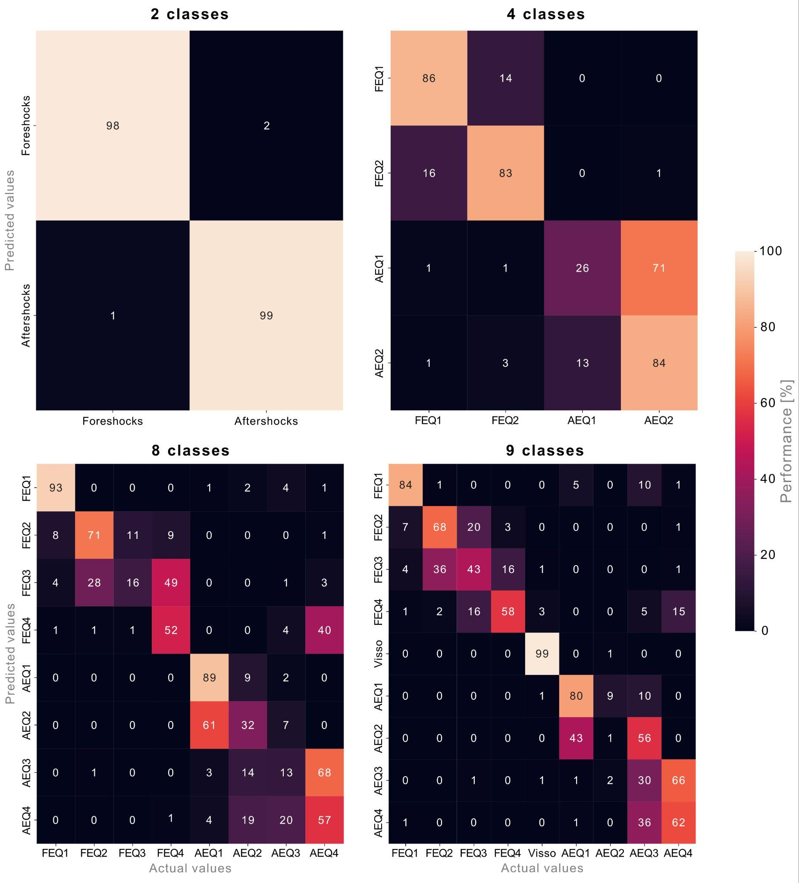
Applications
Earthquake classification: Results

Slide 43
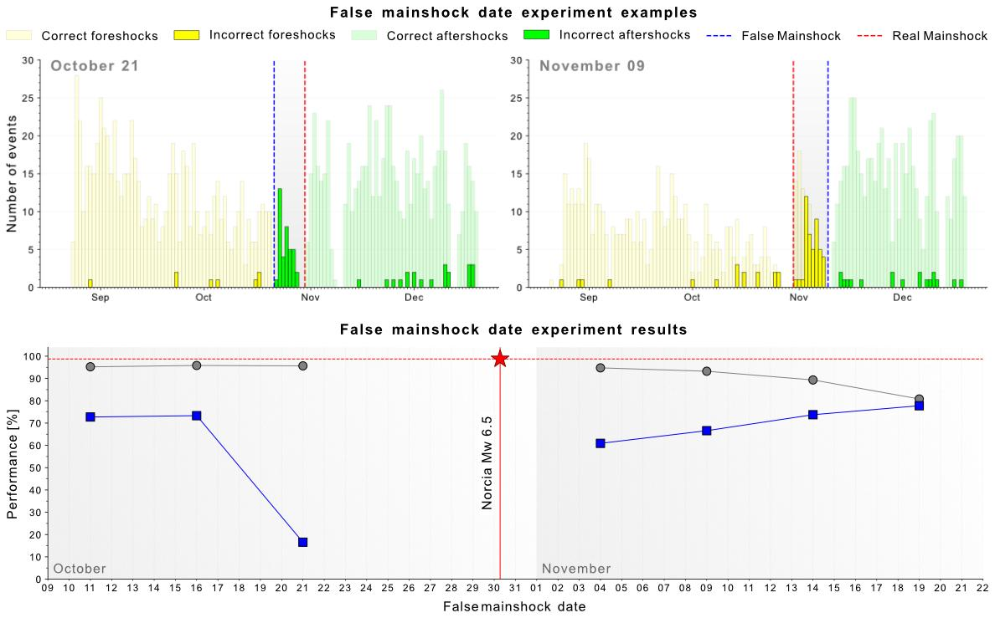
Applications
Earthquake classification: Validation
Re-labeled
data
Results obtained after re-labeling

Slide 44
05.02
Cold Diffusion model

Slide 45
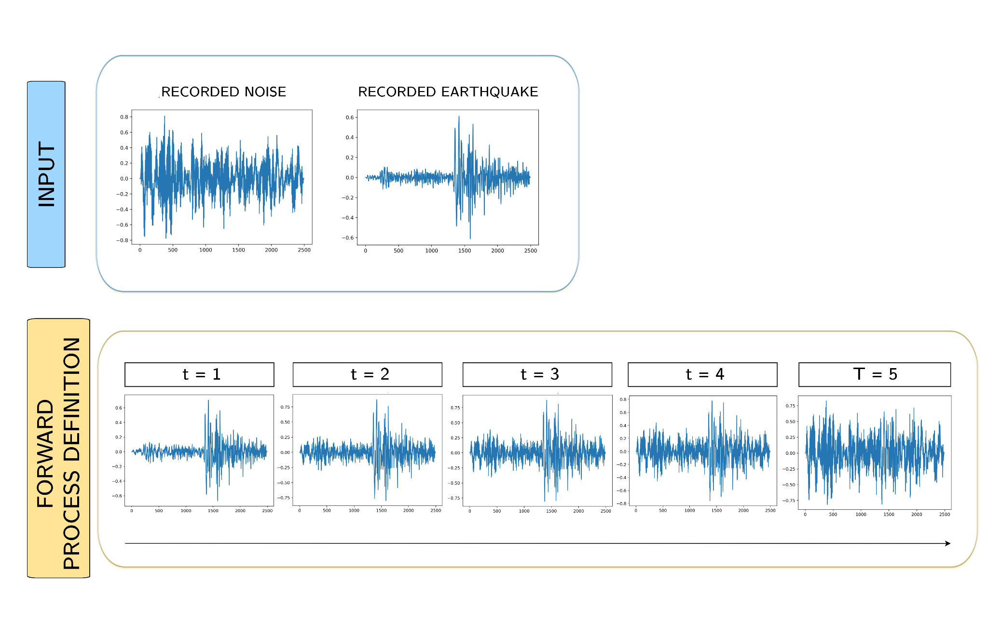
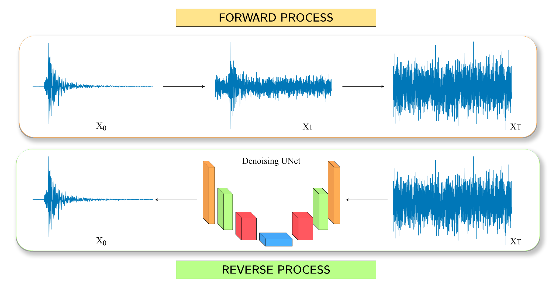
Applications
Cold Diffusion model: Methods
Our research explores adapting the Cold Diffusion model for seismic denoising, tailoring it to overcome the challenge of non-Gaussian noise in seismic data, promising enhanced signal recovery.
Diffusion Process
Input Assumptions

Slide 46
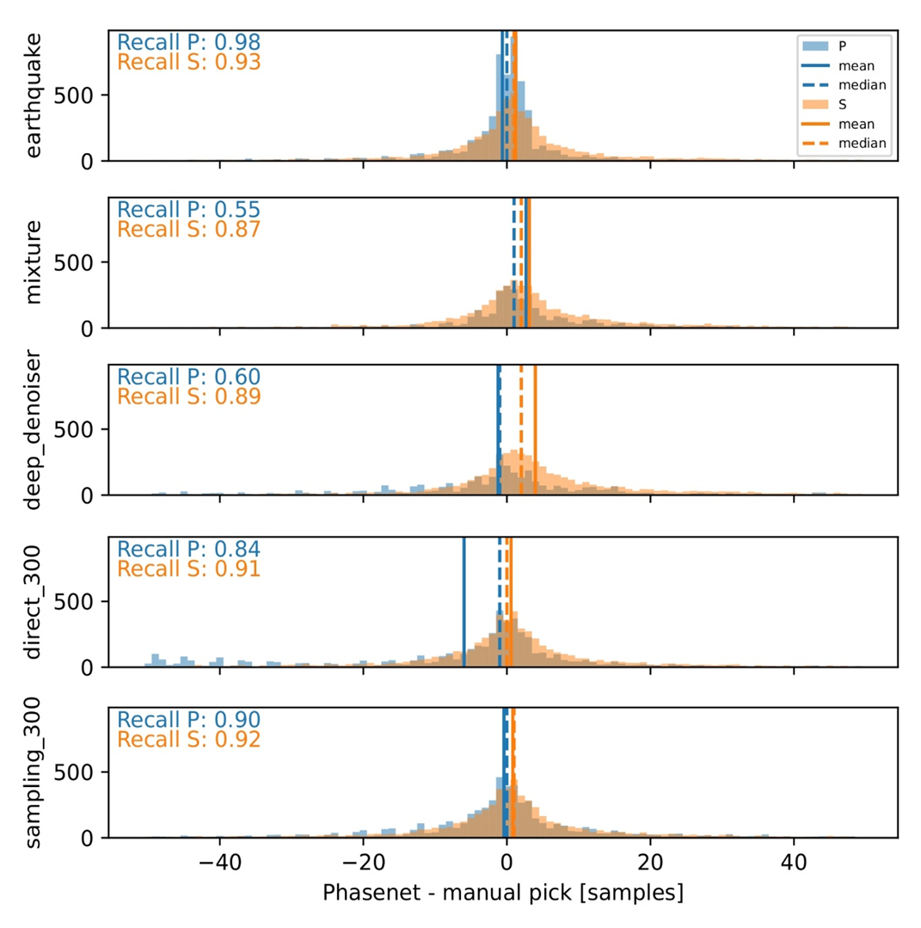
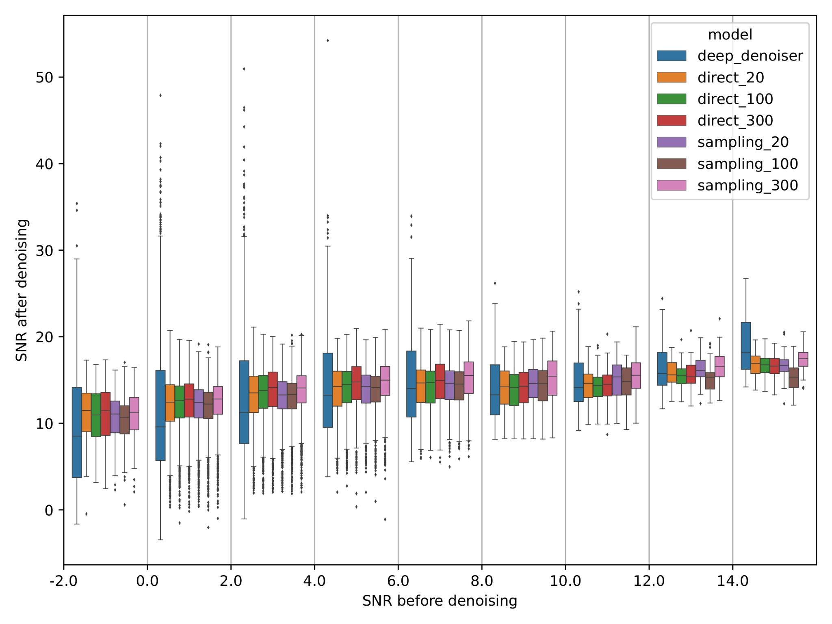
Applications
Cold Diffusion model: Quantitative results
Distributions of SNR values before and after the denoising
Phase arrivals picks

Slide 47
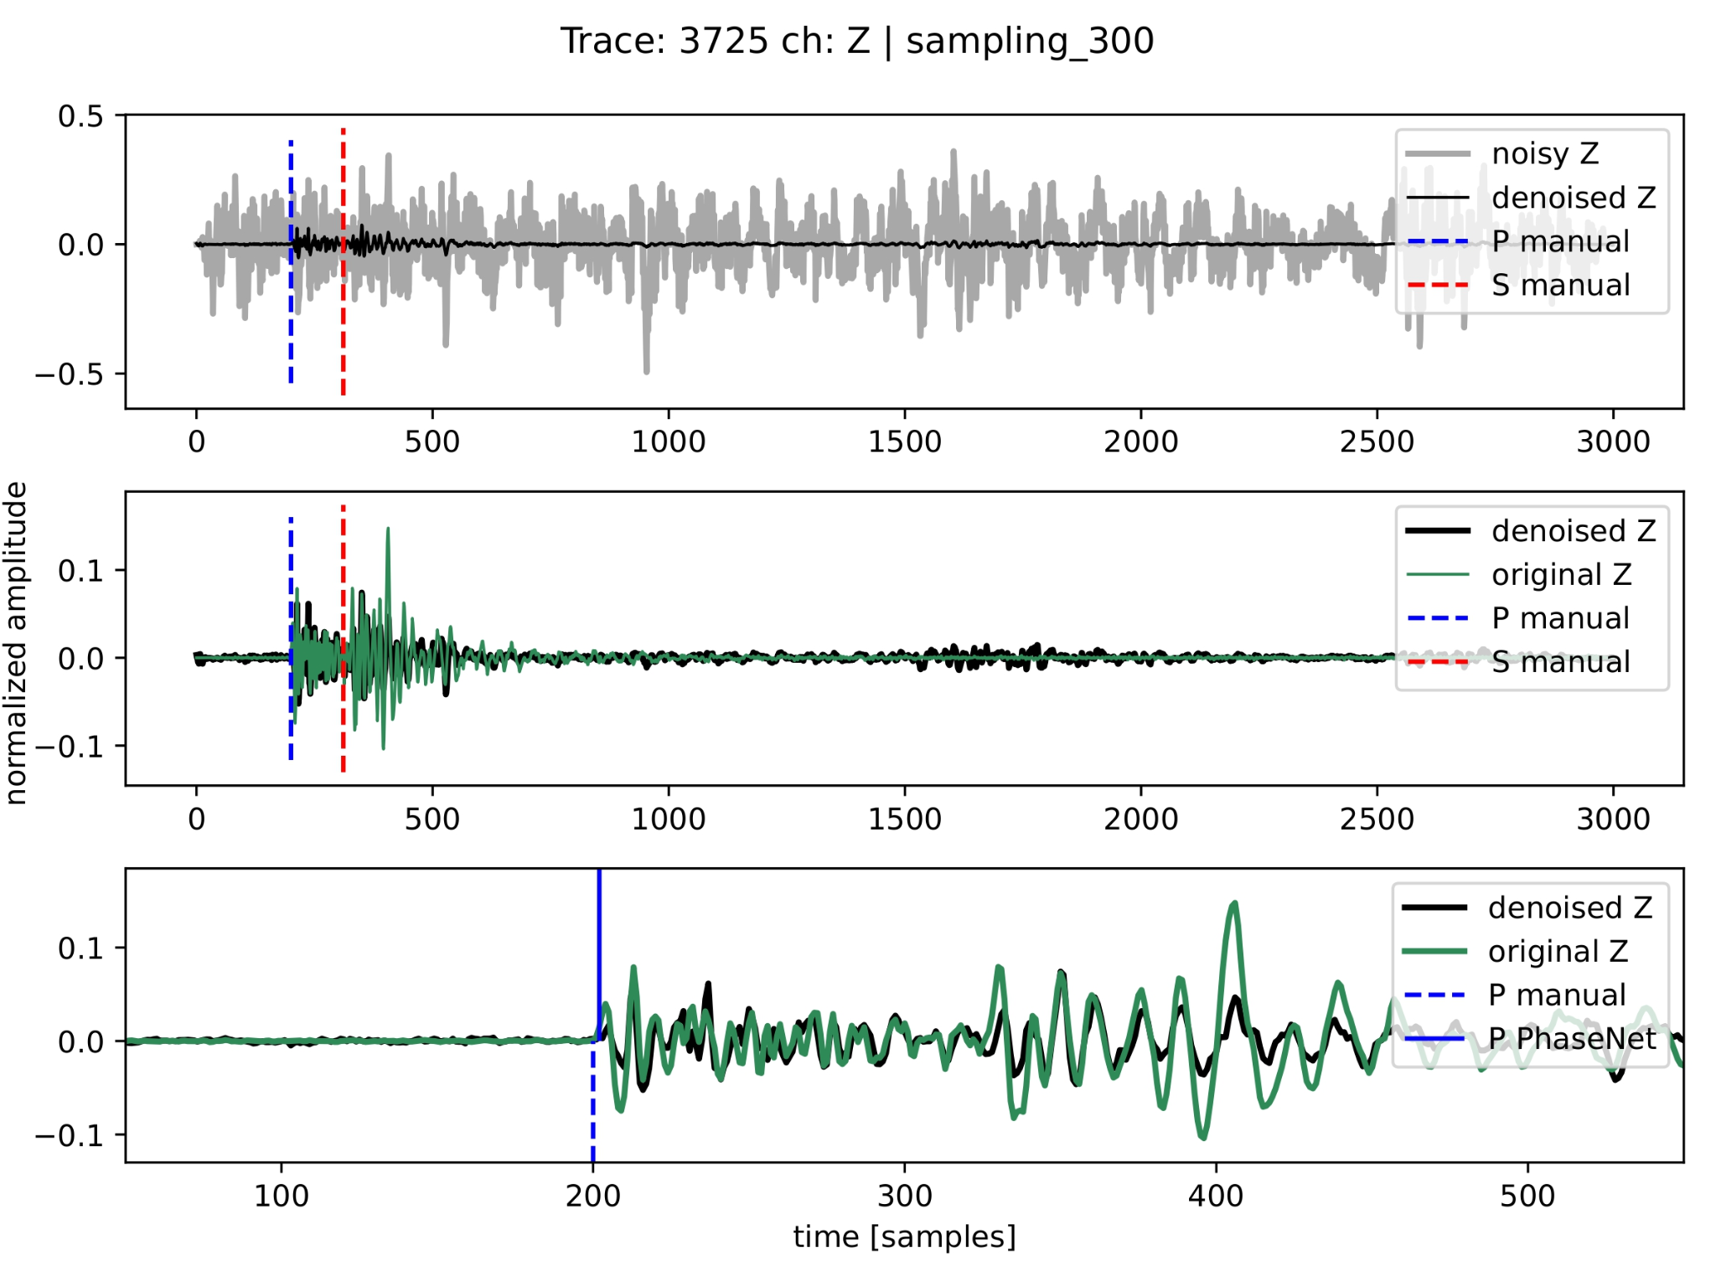
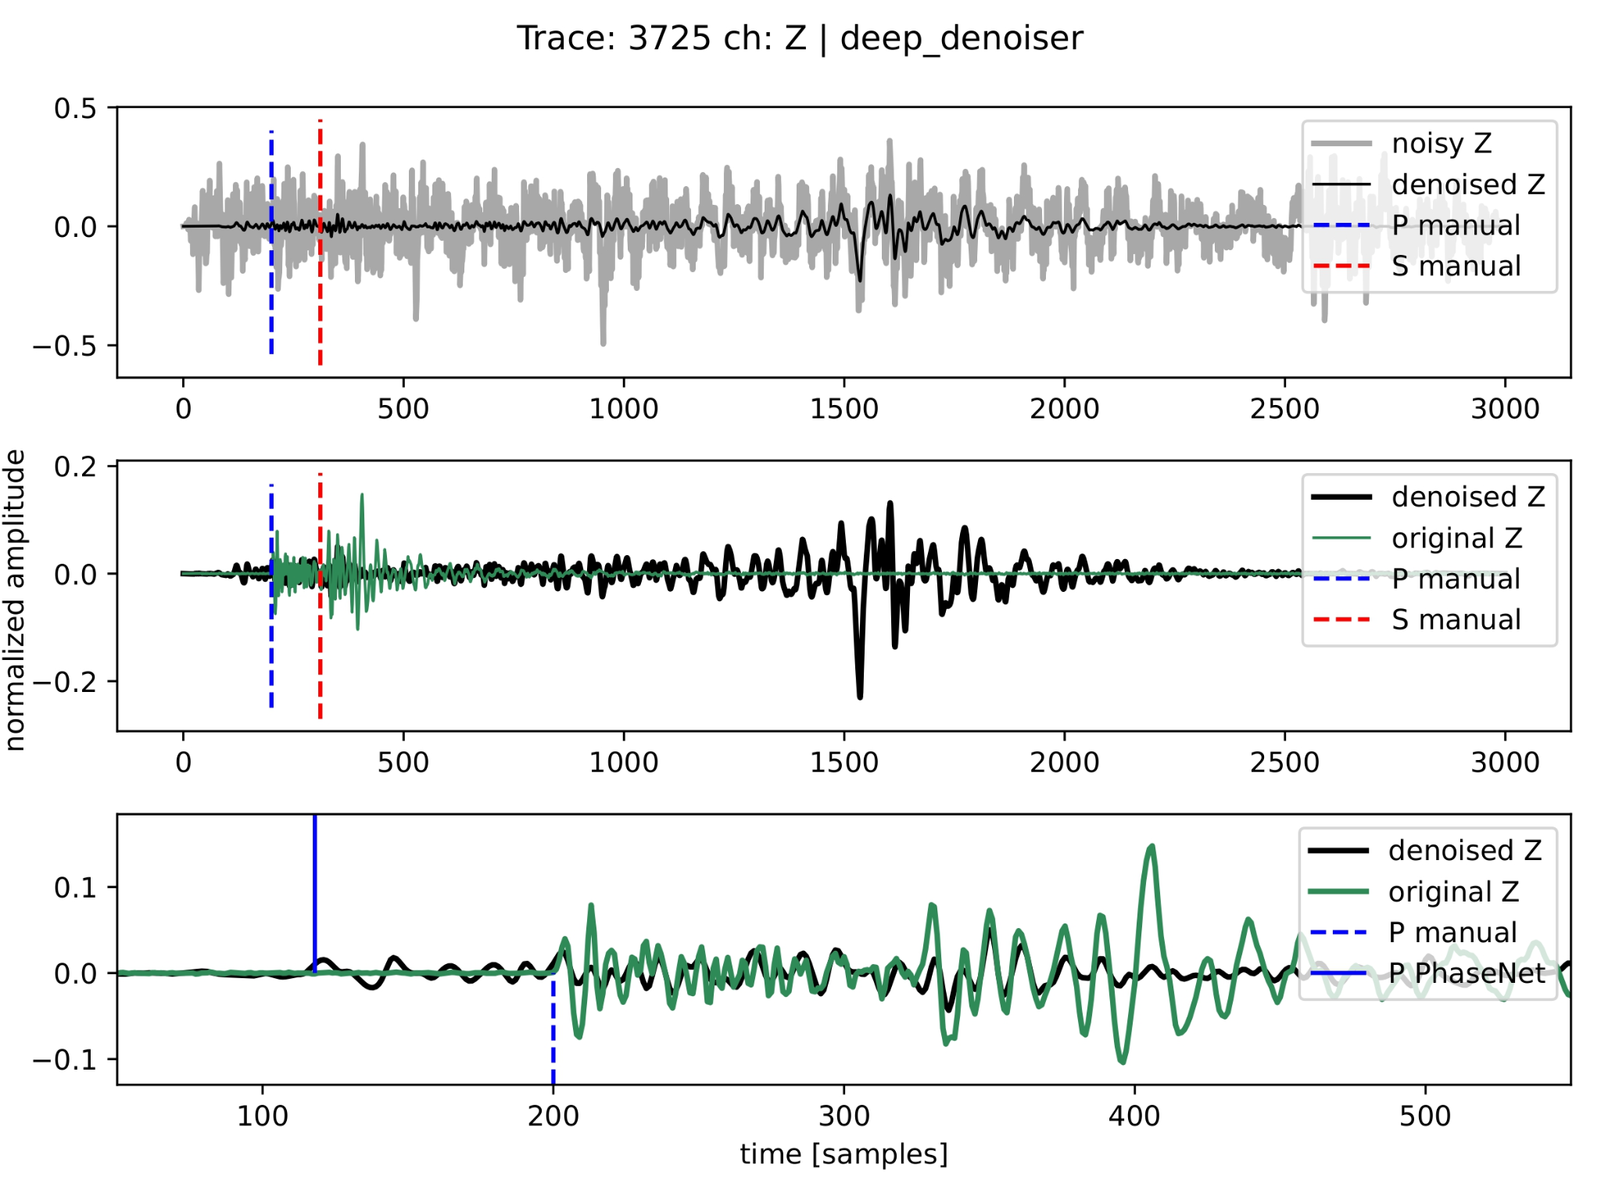
Applications
Cold Diffusion model: Qualitative results

Slide 48
Elements of Seismology & Machine Learning
Now it's your turn to apply machine learning to seismology!
If you have any ideas or questions, here are our contact details:
Gabriele Paoletti
gabriele.paoletti@uniroma1.it
Elisa Tinti
elisa.tinti@uniroma1.it
Daniele Trappolini
daniele.trappolini@uniroma1.it

